Slide 1
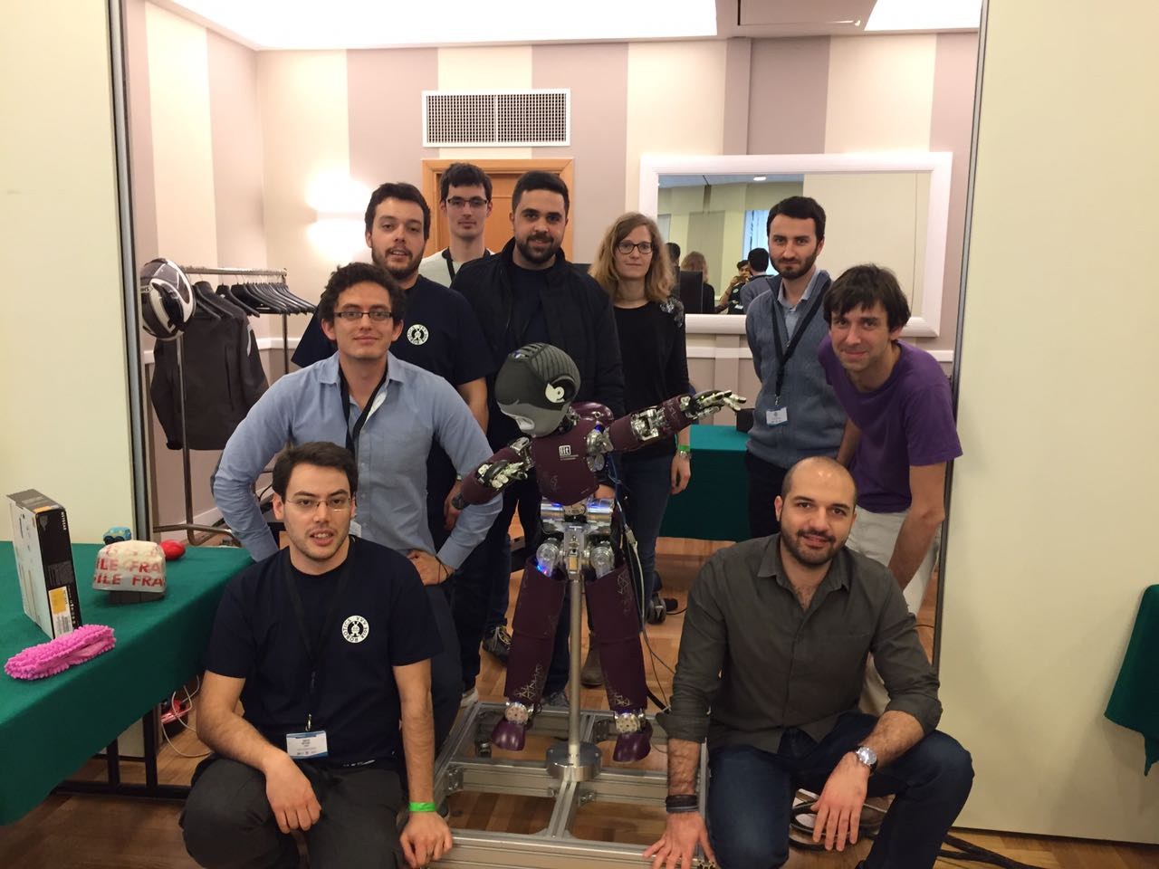
Team Green
Or: How I Learned To Stop Worrying And Love The iCub

Slide 2
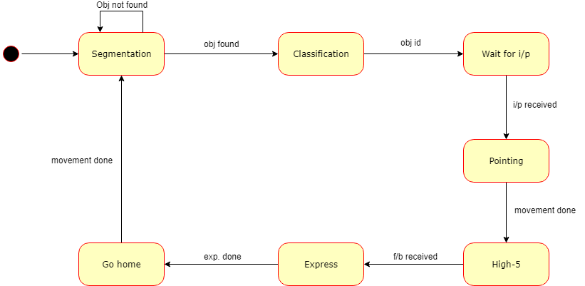
State Diagram

Slide 3
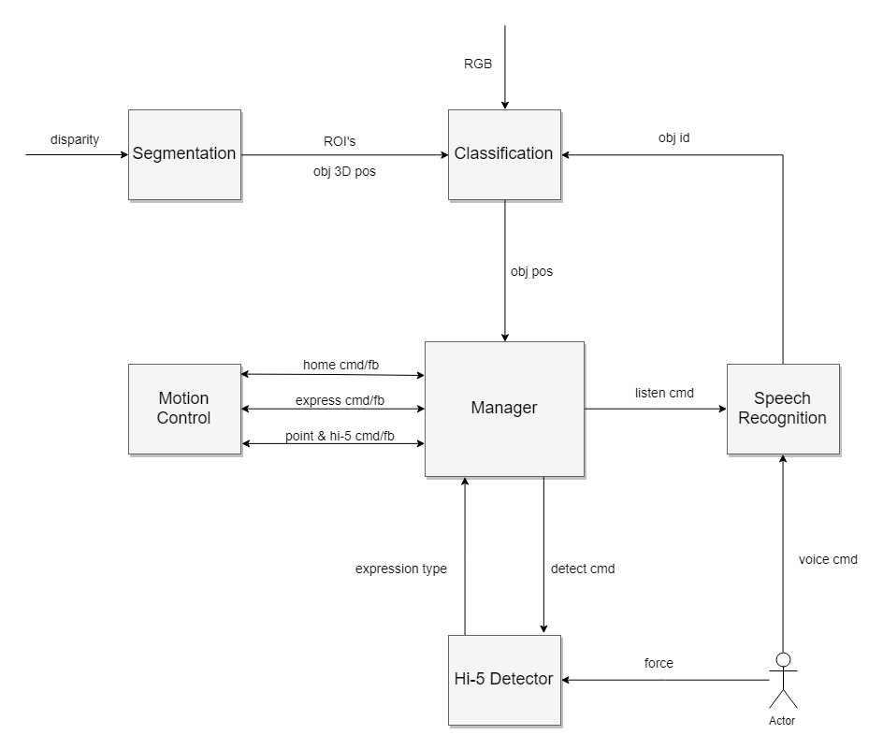
Block Diagram

Slide 4
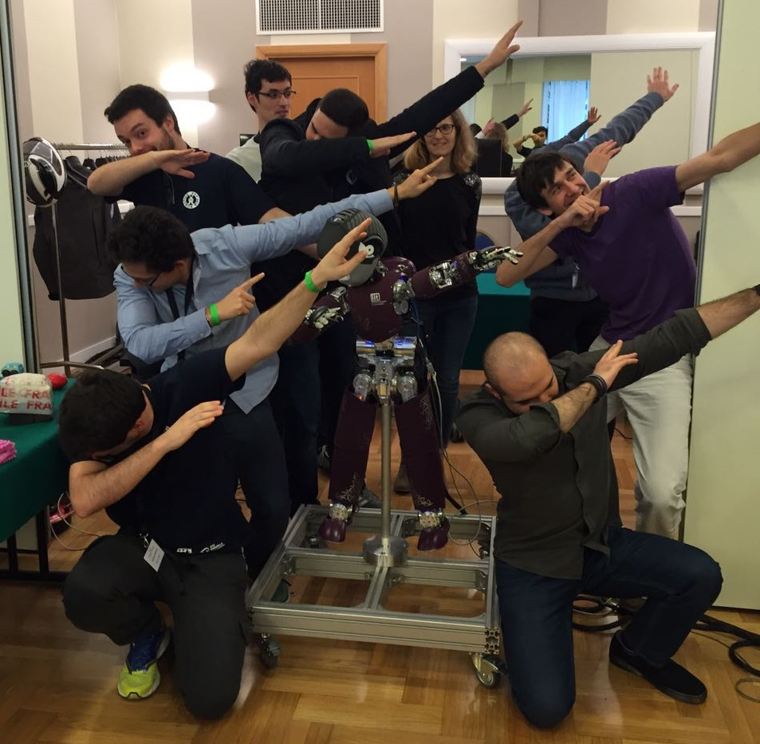
Demo Time!

